Slide 1

CC0003 Ethics and Civics in a Multicultural World
Week 09: Meritocracy
Prof Walid Jumblatt Bin Abdullah

Slide 2
Learning Objectives
By the end of this lecture, you should be able to:
Explain the concept of meritocracy.
Explain the flaws in meritocracy.

Slide 3
Outline
The following topics will be covered in this lecture:
Meritocracy
The Tyranny of Merit
Conclusion

Slide 4
CC0003 Ethics and Civics in a Multicultural World
Week 09: Meritocracy
Topic 01: Introduction
Prof Walid Jumblatt Bin Abdullah

Slide 5
Meritocracy: Concept
The principle of choosing someone for a position based on ‘merit’.
The four types of merit are:
Talent
Hard work
Attitude
Moral character
How do you measure hard work, talent, and attitude?
Usually, but not always, through educational attainments.

Slide 6
Meritocracy: Concept
Meritocracy concerns deservedness, and therefore the understanding of justice.
Outcome (result) is the direct result of effort.
If you work hard, you will succeed.
If you succeed, that means you worked hard.
If you do not work hard, you will not succeed.
If you do not succeed, that means you did not work hard.
Advocates of meritocracy would say it is the most just system.

Slide 7
Meritocracy: Some Proponents
“
“My experience of developments in Asia has led me to conclude that we need good men to have good government. However good the system of government, bad leaders will bring harm to their people. […] The single decisive factor that made for Singapore’s development was the ability of its ministers and the high quality of the civil servants who supported them.”
~ (Lee, 2000)
“

Slide 8
Meritocracy: Some Proponents
“
“Practice of meritocracy in the civil service, in politics, in business and in schools enabled Singaporeans to achieve excellence and to compete against others.”
~ (Goh, 1992)
“

Slide 9
Meritocracy: Some Proponents
“
“Since then, we have held firmly to the belief that before race, language and religion, first and foremost, we should all be Singaporeans together and so, we have built a fair and just society, based on meritocracy, where ability and not your background or the colour of your skin, determines how well you do, determines what contributions you make, and what rewards you get.”
~ (Lee, 2000)
“

Slide 10
Meritocracy: Benefits
Social mobility
A person can move up into a socio-economic class.
Ensures fairness
Skin colour, faith, gender etc. does not matter in determining where one ends up in life.
Keeps faith in the system
If you believe you can get to a better station in life with hard work, you will have trust in the system.
The best would emerge as competition makes everyone else better.
Results in best outcomes for everyone

Slide 11

Meritocracy
Don’t Feel Bad
Good Try

Slide 12
Meritocracy: The Other Side
However, for meritocracy to work, people must begin from the same, or at least similar, starting point(s).
Otherwise, all the benefits of meritocracy would dissipate
No social mobility
Not fair
No faith in the system
Not the best outcome
Is this true?

Slide 13
Acknowledgements:
Slide 1 and 4: freshidea (n.d.). Meritocracy Concept [Photograph]. Adobe Stock Images. https://stock.adobe.com/sg/images/meritocracy-concept/288612849
Slide 7: Lee, K.Y. (2000). From Third World to First, The Singapore Story: 1965–2000. Times Media.
Slide 8: Goh, C.T. (1992). My urgent mission. Petir. Nos 11-12/92, pp. 10-19.
Slide 9: Lee, K.Y. (2000). From Third World to First, The Singapore Story: 1965–2000. Times Media.
Slide 11: bioraven (n.d.). Trophy in gold [Photograph]. Adobe Stock Images. https://stock.adobe.com/sg/images/trophy-in-gold/21987464

Slide 14
CC0003 Ethics and Civics in a Multicultural World
Week 09: Meritocracy
Topic 02: The Tyranny of Merit
Prof Walid Jumblatt Bin Abdullah

Slide 15
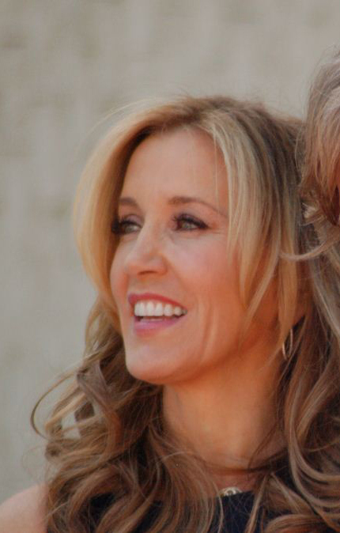

The Tyranny of Merit: College Admissions Scandal
Felicity Hoffman
(Desperate Housewives)
Lori Loughlin
(Full House)
2019 College Admissions Scandal

Slide 16
The Tyranny of Merit: College Admissions Scandal
The scandal provoked universal outrage.
Most people expressed unhappiness and contempt for how the wealthy and powerful can rig the system.
Questions of justice and fairness were behind the discontentment.
However,
How is what the parents did different from what most parents do?
How is it different from tuition; enrichment; buying the best equipment for the children?
Wouldn’t differences in wealth affect the ‘meritocratic outcome’?

Slide 17




The Tyranny of Merit: Tuition Industry
DAILY NEWS
SINGAPORE
Tuition has ballooned to a S$1.4b industry in Singapore. Should we be concerned?

Slide 18
The Tyranny of Merit: Inherited Meritocracy
Empirically, wealth is the best predictor of educational performance. (Sandel, 2021)
It makes logical sense too.
So, if wealth predicts income better than any other factor, is meritocracy undermined?
Hereditary meritocracy is a term introduced by Ben Bernanke in 2015
In a sense, the college admissions scandal is an extension of the meritocratic system, isn’t it?

Slide 19
The Tyranny of Merit: Problems of Meritocracy
Different starting points
The rich get richer; the poor get poorer.
Who defines merit?
Do well-educated people make better politicians/leaders, for example?
Transforms our ‘soul’
We start looking at others in terms of their values, rather than in terms of our values.
Makes humans ultra-competitive.

Slide 20
The Tyranny of Merit: Problems of Meritocracy
“
“As the meritocracy intensifies, the striving so absorbs us that our indebtedness recedes from view. In this way, even a fair meritocracy, one without cheating or bribery or special privileges for the wealthy, induces the mistaken impression that we have made it on our own.”
~ (Sandel, 2021)
“

Slide 21
The Tyranny of Merit: Solutions
What then, do we do? Should we abandon meritocracy?
Abandoning it may lead to problems which plague other societies and civilisations.
Preferential treatment based on race and religion, for instance, would be markedly worse than hereditary meritocracy!
However, hereditary meritocracy is definitely a problem too.
At the very least, refinements need to be made to meritocracy.

Slide 22
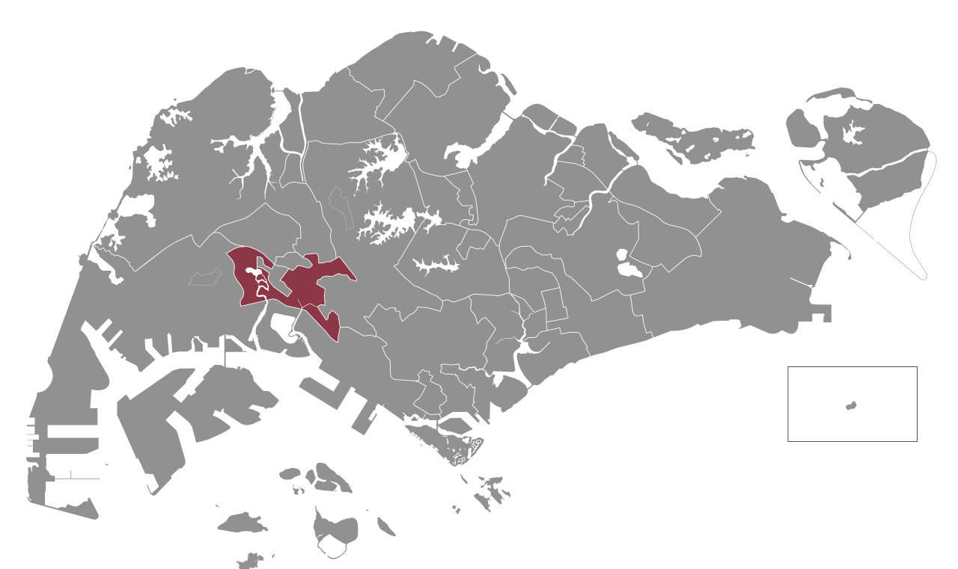
The Tyranny of Merit: Solutions
Group Representation Constituency (GRC) is an example.
Electoral boundary of Jurong GRC
Jurong GRC Members:
Tharman Shanmugaratnam
Tan Wu Meng
Rahayu Mahzam
Shawn Huang
Xie Yao Quan

Slide 23
The Tyranny of Merit: Solutions
The GRC attempts to reconcile two core ideologies of Singapore which, at times, can be contradictory, multiracialism and meritocracy.
The two do not always contradict as meritocracy is often the best way to ensure no racial tensions emerge (since there shouldn’t be any preferential treatment).
However, pure meritocracy may result in a lack of representation of minorities. For instance, if racial voting occurs.

Slide 24


The Tyranny of Merit: Solutions
The GRC guarantees minority representation.
Is there a compromise in quality?
Perhaps there is a compromise.
But the question is, how big is that compromise, and is it worth the trade-off?
The GRC is a form of affirmative action in the political arena.
Should we explore other forms of affirmative action in the economic sphere?

Slide 25
Acknowledgements:
Slide 14: freshidea (n.d.). Meritocracy Concept [Photograph]. Adobe Stock Images. https://stock.adobe.com/sg/images/meritocracy-concept/288612849
Slide 15: Felicity Huffman. (2021, June 28). In Wikipedia. https://en.wikipedia.org/wiki/Felicity_Huffman
Slide 15: Lori Loughlin. (2021, July 13). In Wikipedia. https://en.wikipedia.org/wiki/Lori_Loughlin
Slide 17: suriyapong (n.d.). Studio shot of Smartphone iphoneX with blank white screen for Infographic Global Business Marketing investment Plan, mockup model similar to iPhone 11 Pro Max. [Photograph]. Adobe Stock Images. https://stock.adobe.com/sg/images/studio-shot-of-smartphone-iphonex-with-blank-white-screen-for-infographic-global-business-marketing-investment-plan-mockup-model-similar-to-iphone-11-pro-max/297351123
Slide 17: Nuthawut (n.d.). Student loan payment calculation, scholarship or saving for school and education concept, white piggy bank wearing graduation hat on calculator on yellow background with copy space [Photograph]. Adobe Stock Images. https://stock.adobe.com/sg/images/student-loan-payment-calculation-scholarship-or-saving-for-school-and-education-concept-white-piggy-bank-wearing-graduation-hat-on-calculator-on-yellow-background-with-copy-space/328986838
Slide 17: Kumon. (2021, July 5). In Wikipedia. https://en.wikipedia.org/wiki/Kumon
Slide 17: British Council. (2021, July 21). In Wikipedia. https://en.wikipedia.org/wiki/British_Council
Slide 18 and 20: Sandel, M. (2021). Tyranny of Merit. (1st ed.). Penguin Books, p.21.
Slide 22: Jurong Group Representation Constituency. (2021, July 21). In Wikipedia. https://en.wikipedia.org/wiki/Jurong_Group_Representation_Constituency

Slide 26
CC0003 Ethics and Civics in a Multicultural World
Week 09: Meritocracy
Topic 03: Conclusion
Prof Walid Jumblatt Bin Abdullah

Slide 27
Conclusion
Meritocracy is a core ideology in Singapore.
In fact, it is the reason for Singapore’s existence as a nation.
However, that does not mean meritocracy is not without its flaws.
Hereditary meritocracy may undermine the entire concept’s utility.
No public policy can ever be perfect: The question is, what are the sacrifices/ trade-offs we are willing to make?

Slide 28
Questions
How and by whom should merit be defined?
Is (hereditary) meritocracy the cause of inequality?
Is there even a problem with hereditary meritocracy?
How should we resolve the problems of meritocracy? Should affirmative action even be on the table?
Are your generation’s views on meritocracy different from your elders?

Slide 29
Acknowledgements:
Slide 26: freshidea (n.d.). Meritocracy Concept [Photograph]. Adobe Stock Images. https://stock.adobe.com/sg/images/meritocracy-concept/288612849

Slide 30
